Slide 1
Walmart Sales Analysis Using MySQL Techniques
SQL Queries And Business Insights
Name : Ayush Namdev 1st Batch
Data Science

Slide 2
INTRODUCTION
Walmart operates across multiple cities and offering a wide range of products.
The dataset includes transaction data, customer demographic, product lines, sales figure and payment method.
The project uses MySQL to analyze sales performance, customer behavior, operational efficiencies and trends.

Slide 3
Business Problem
Walmart wants to optimize its sales strategies.
The analysis focuses on identifying sales trends, customer segmentation and product profitability.

Slide 4
Dataset description
Dataset includes:
Branch – wise sales data
Customer purchase behaviour
Payment methods and product lines
Sales volume and transaction trends
Source: Walmart Sales Dataset

Slide 5
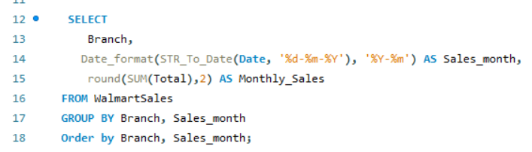
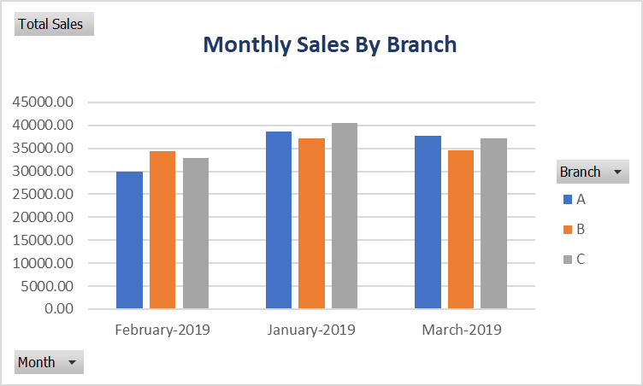
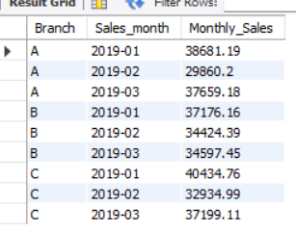
Task 1st : Identifying the Top Branch by Sales Growth Rate
Walmart wants to identify which branch has exhibited the highest sales growth over time. Analyze the total sales for each branch and compare the growth rate across months to find the top performer.
Step 1st Extract Monthly sales Data – First, I calculate total sales for each branch group by month.
Input :-
Output :-

Slide 6
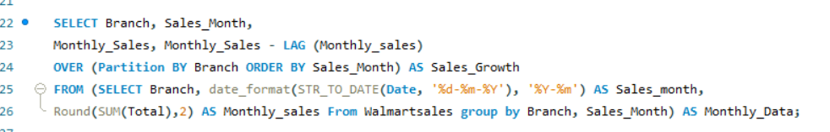
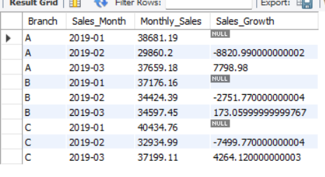
Step 2nd : Calculate Month-over-Month Growth
Input :-
Output :-

Slide 7
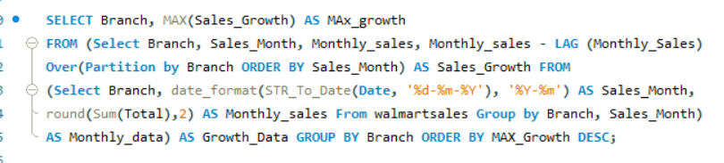
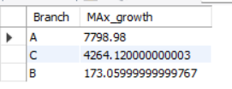
Step 3rd : Identify the top Branch
Input :-
Output :-
Insights :- The branch exhibiting the highest sales growth over time will likely have strong customer retention, effective promotions, or seasonal demand spikes. Analyzing monthly growth trends helps Walmart optimize strategies for slower-performing branches.
Approach :- Use LAG() to compare monthly sales and identify trends.

Slide 8
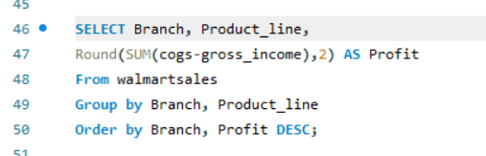
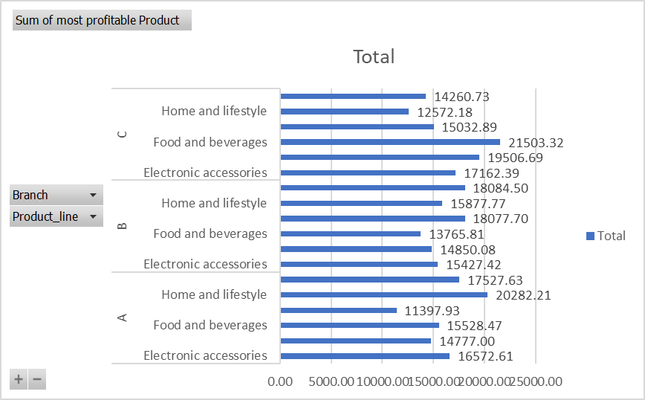
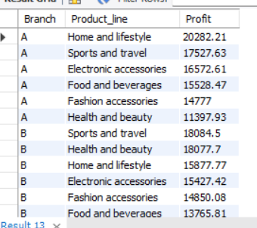
Task 2nd : Finding the most Profitable Product Line for Each Branch
Walmart needs to determine which product line contributes the highest profit to each branch. The profit margin should be calculated based on the difference between the gross income and cost of goods sold.
Step 1st Calculate Profit For Each Product line
Input :-
Output :-

Slide 9
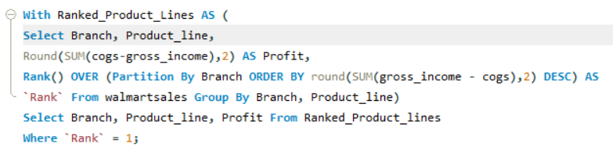
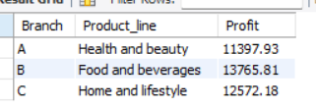
Step 2nd Rank product line within each Branch
Input :-
Output :-
Insights :- High-profit product lines may indicate premium pricing, lower costs, or strong demand. Walmart can use this insight to expand high-margin product lines and optimize inventory allocation.
Approach :- Calculate Profit as (Cogs – gross income) and rank product lines per branch.

Slide 10
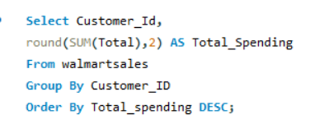
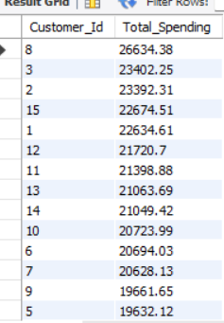
Task 3rd : Analyzing Customer Segmentation Based on spending.
Walmart wants to segment customers based on their average spending behavior. Classify customers into three tiers: High, Medium, and Low spenders based on their total purchase amounts.
Step 1st Calculate Total spending Per customer
Input :-
Output :-

Slide 11
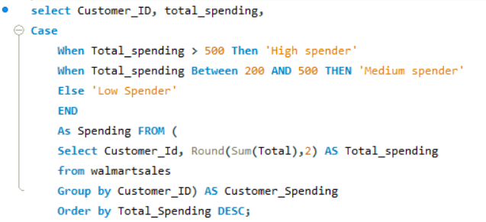
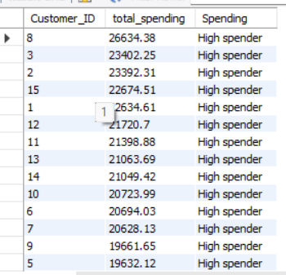
Step 2nd Define spendings
Input :-
Output :-
Insights :- Categorizing customers into High, Medium, and Low spenders enables Walmart to target promotions effectively. High spenders might be loyal customers, while lower spenders could be engaged through discounts.

Slide 12
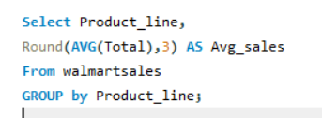
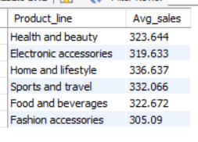
Task 4th : Detecting Anomalies in Sales Transactions.
Walmart suspects that some transactions have unusually high or low sales compared to the average for the product line. Identify these anomalies.
Step 1st Calculate the Average Sales for each Product line
Input :-
Output :-

Slide 13
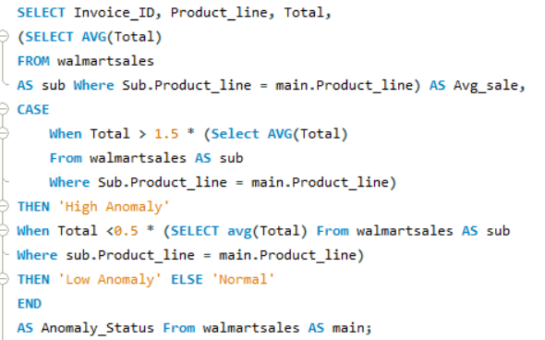
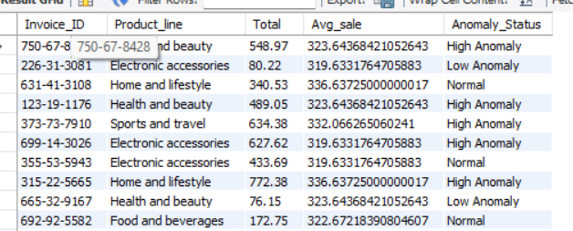
Step 2nd Compare Transaction to the Average
Input :-
Output :-

Slide 14
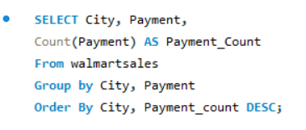
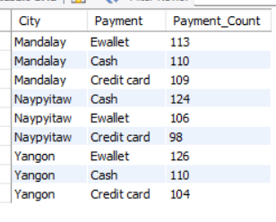
Task 5th : Most Popular Payment method by City.
Walmart needs to determine the most popular payment method in each city to tailor marketing strategies.
Step 1st Aggregate payment Method Counts by City
Input :-
Output :-

Slide 15
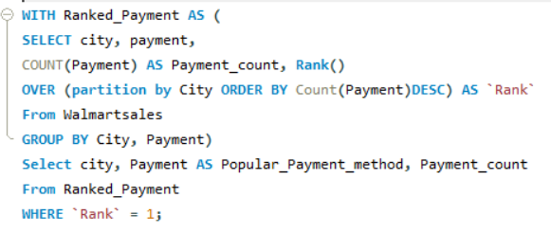
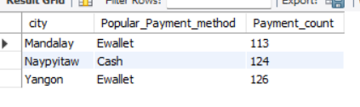
Step 2nd Identify the most popular payment method per city
Input :-
Output :-
Insights :- Knowing the preferred payment method helps Walmart optimize checkout experience. If a city prefers digital payments, Walmart can enhance related infrastructure.
Approach :- GROUP BY city and count payment methods.

Slide 16
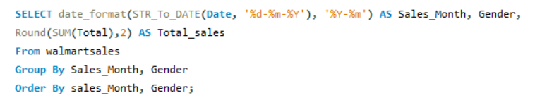
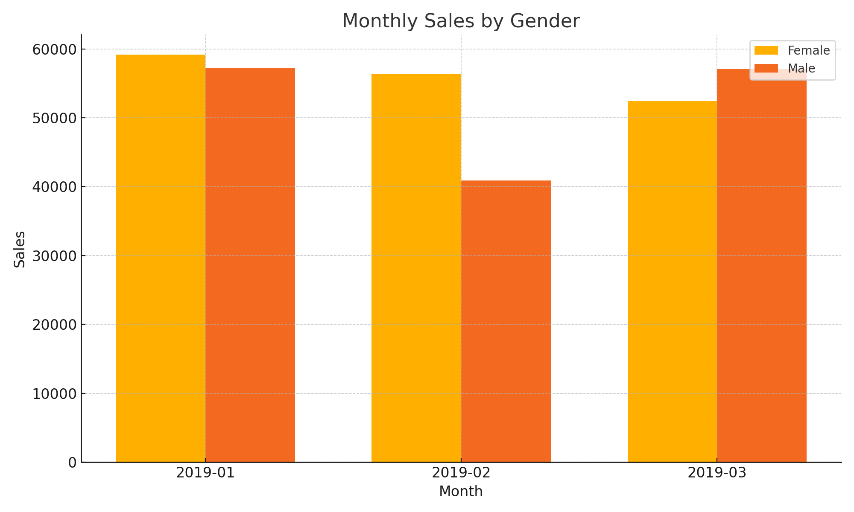
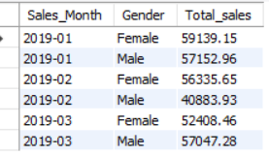
Task 6th : Monthly Sales Distribution by Gender
Walmart wants to understand the sales distribution between male and female customers on a monthly basis.
Step 1st Extract Monthly Sales Data
Input :-
Output :-

Slide 17
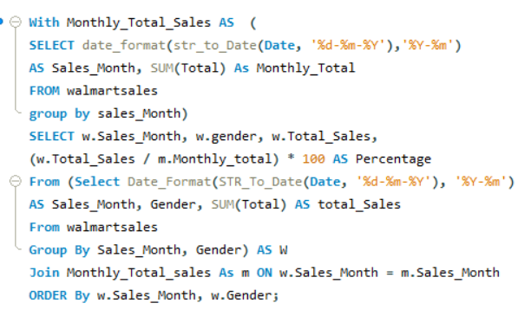
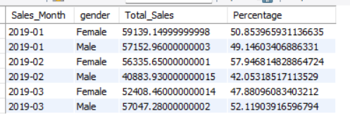
Step 2nd Calculate sales Distribution
Input :-
Output :-
Insights :- Understanding sales trends by gender helps Walmart design gender-targeted promotions and identify which products appeal more to certain demographics.
Approach :- Analyze monthly totals for Male vs. Female customers.

Slide 18
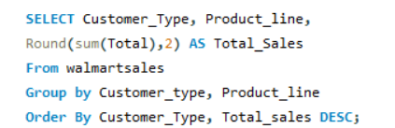
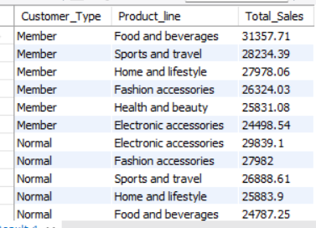
Task 7th : Best Product line by Customer Type
Walmart wants to know which product lines are preferred by different customer types(Member vs. Normal).
Step 1st Calculate Total sales for Each Product line by Customer types
Input :-
Output :-

Slide 19
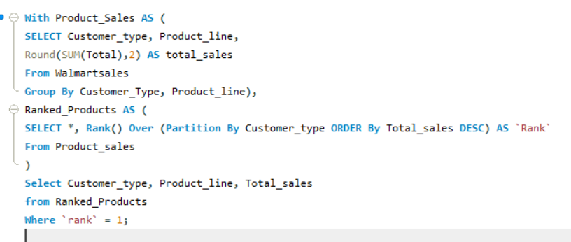
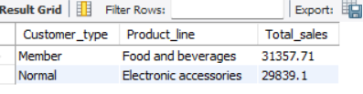
Step 2nd Identify the best product line per Customer type.
Input :-
Output :-
Insights :- Members vs. Normal customers might prefer different products. Walmart can adjust loyalty programs based on purchase trends.
Approach :- Rank product lines per customer type.

Slide 20

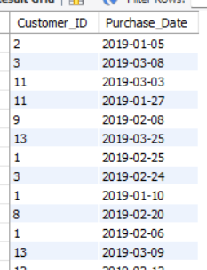
Task 8th : Identifying Repeat Customers
Walmart needs to identify customers who made repeat purchases within a specific time frame (e.g., within 30 days).
Step 1st Convert the date format
Input :-
Output :-

Slide 21
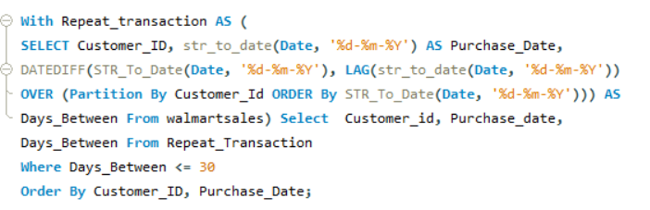
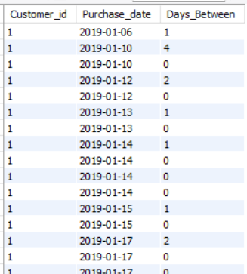
Step 2nd Identify Repeat Purchase
Input :-
Output :-

Slide 22
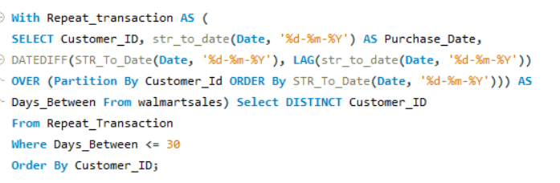
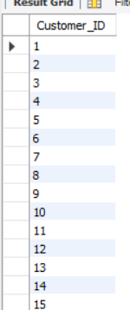
Step 3rd Aggregate Repeat Customers
Input :-
Output :-
Insights :- Repeat customers indicate loyalty and customer satisfaction. Walmart can create personalized promotions for frequent buyers.
Approach :- Use DATEDIFF() to find customers purchasing within a 30-day window.

Slide 23
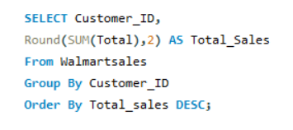
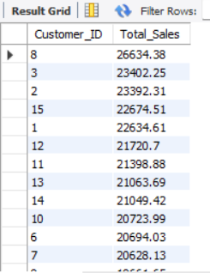
Task 8th : Findings Top 5 Customers by Sales Volume
Walmart wants to reward its top 5 customers who have generated the most sales Revenue.
Step 1st Calculate total Sales Per Customer
Input :-
Output :-

Slide 24
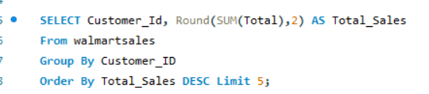
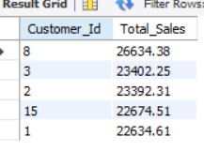
Step 2nd Select the Top 5 Customers
Input :-
Output :-
Insights :- Rewarding top customers with loyalty benefits increases engagement. This insight helps Walmart strengthen customer relationships.

Slide 25
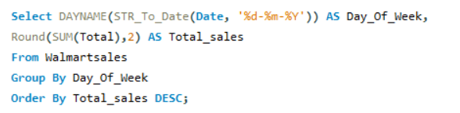
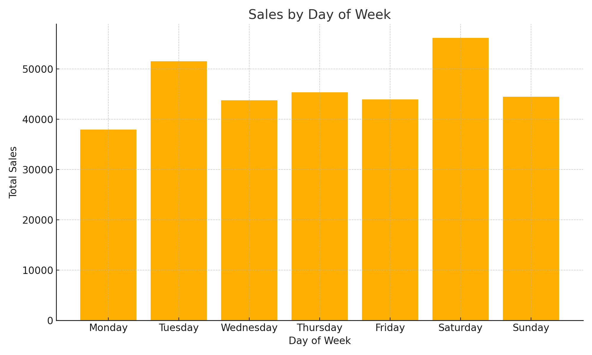
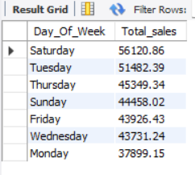
Task 10th : Analyzing Sales Trends by Day of the Week
Walmart wants to analyze the sales patterns to determine which day of the week brings the highest sales.
Step 1st Extract the day of the week
Input :-
Output :-

Slide 26
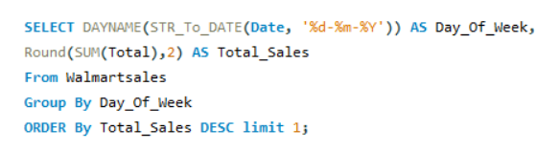

Step 2nd Identify the day with the Highest Sales
Input :-
Output :-

Slide 27
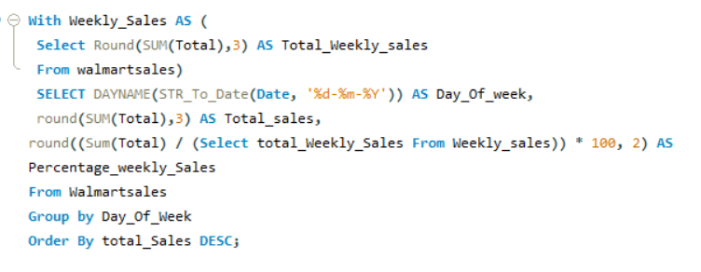
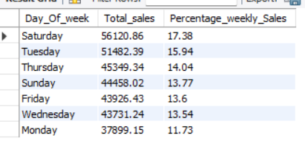
Step 3rd Additional Insights
Input :-
Output :-
Insights :- Identifying peak sales days helps plan staffing, promotions, and inventory better.
Approach :- GROUP BY Day and analyze daily totals.

Slide 28
KEY INSIGHTS
Branch Performance: Branch A exhibited notable sales growth, while Branch C achieved the highest profitability.
Top Product Lines: Each branch has a unique top-performing product line, requiring localized promotion strategies.
Customer Segmentation: High-spending and repeat customers significantly contribute to overall sales—ideal for loyalty targeting.
Payment Preferences: E-wallets are dominant in Yangon and Mandalay, whereas cash is preferred in Naypyitaw.
Gender & Monthly Trends: Female customers led spending in early months; weekend (especially Saturday) sales are highest.
Sales Anomalies: Detected irregularities in specific product lines; regular audits can prevent revenue leakage.
Day-Wise Trends: Peak sales occur on Saturday, followed by Tuesday, guiding staffing and marketing decisions.

Slide 29
Conclusion
In conclusion, the analysis of Walmart’s sales data uncovers crucial insights into branch-wise performance, customer segmentation, and purchasing behavior. Branch C emerged as the most profitable overall, while Branch A showed strong sales growth potential—offering a model for replication. Product-line profitability varied by location, emphasizing the need for branch-specific inventory and marketing strategies. Additionally, the identification of high-value and repeat customers presents an opportunity to strengthen loyalty through personalized engagement. Variations in payment preferences and gender-based sales trends further support the value of regional customization. By addressing anomalies, optimizing inventory, and aligning operations with data-driven insights, Walmart can enhance both profitability and customer satisfaction.

Slide 30
Project Walk‑through Video Videohttps://drive.google.com/file/d/1BZRX3LIJpZCTh0Njh6d5DQvr6-VsobKF/view?usp=drive_link

